Slide 1
NC Ordering Application
M K Apoorva
Arpitha Raghunandan
Madhuparna Bhowmik

Slide 2
INTRODUCTION
Considering the efforts needed to order food from the many night canteens around our campus, we decided to make an application to simplify the ordering process. Our application allows one to choose one of the night canteens around campus and place an order after providing their name and phone number. The application also generates and displays a bill for the user.
It centralizes the ordering of food from night canteens.

Slide 3
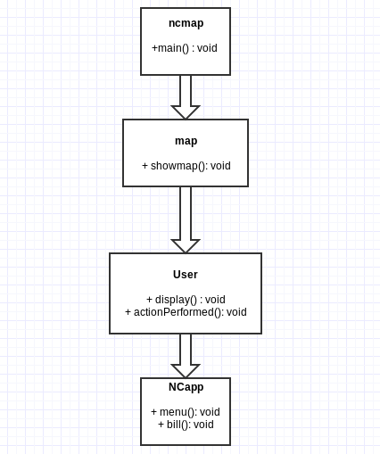
CLASS DIAGRAM

Slide 4
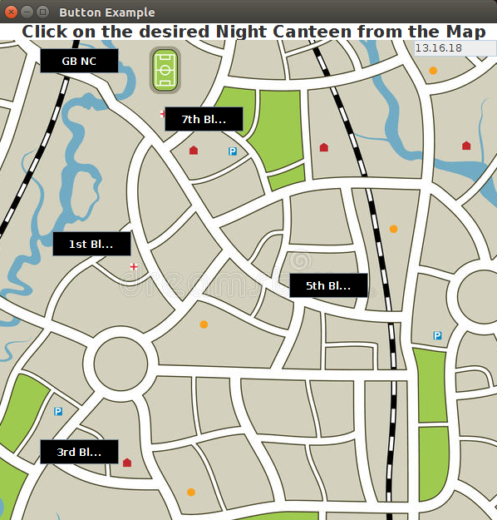
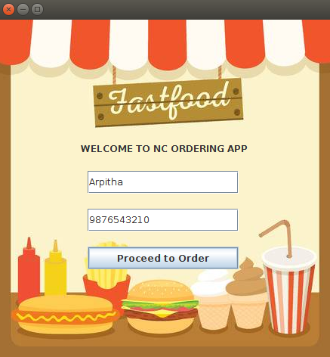
OUTPUT

Slide 5
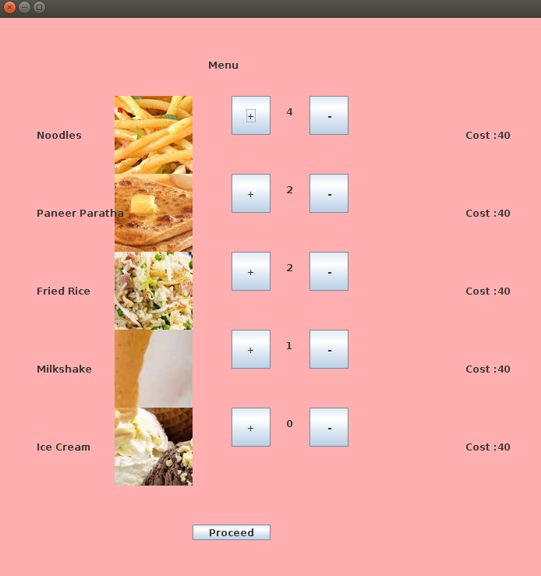
OUTPUT

Slide 6
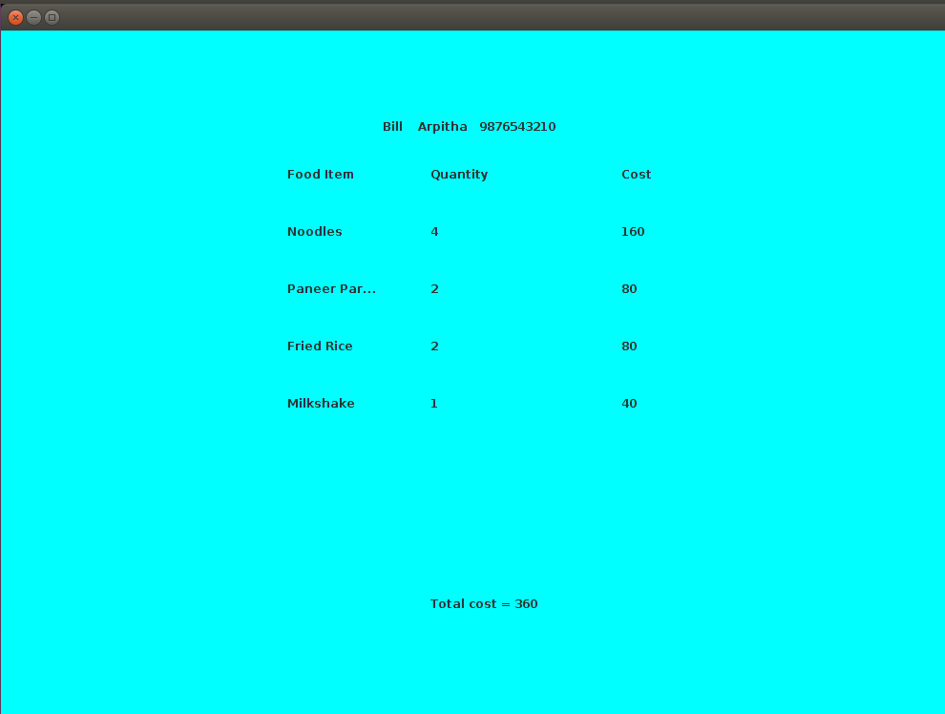
OUTPUT

